Slide 1
The Convenience Factor: Residential Valuation Using Machine Learning
A Haystacks.ai Project

Slide 2
Introduction
Haystacks.ai has conducted extensive analysis on internal amenities (in-complex daycare, gyms) and their effect on rental prices.
Now, we want to find out how external amenities, such as grocery stores and schools, directly influence rental price.
These external amenities will be referred to as “Points of Interests” or POIs

Slide 3
How do external amenities impact rental prices on Build-to-Rent and Single/Multi Family Rental Homes?
Which external amenities significantly influence rental price the most?
To what extent does distance affect rental prices in regards to selected external amenities?
The Business Questions

Slide 4
Convenience (As a Feature)
Grocery stores are divided into traditional and non-traditional types, are dependent on their regions, and are occasionally divided between their size, price of goods, or even year-end sales.
Supermarket | A large shop for groceries. It's a full service grocery store that often sells a variety of non-food products as well. Almost always part of a chain (Publix, Harris Teeter, Piggly Wiggly, BiLo, Ingles, Bells, Earthfare).
Variety Store | A variety store or price-point retailer is a retail shop that sells inexpensive items, usually with a single price point for all items in the store (Dollar Tree, Family Dollar, Dollar General).
Warehouse Club | A non-traditional membership-retailer hybrid that sells bulk products in a warehouse environment. At least 40% of products devoted to grocery (Costco, Sam’s Club, BJ’s).
Supercenter | A non-traditional food and drug store combination that sells mass merchandise. At least 40% of products devoted to grocery (Target, Walmart).
Convenience Store | A non-traditional, limited store that sells variety of general merchandise, including packaged food products (7-Eleven, Quick Trip.)

Slide 5
What Does the Literature Say?
Distance is Statistically Significant
Type of Store Matters
It was consistently shown that, the closer a home was to selected amenities, there was an increase in rental prices. This both applied to higher income households and low income households.
Higher income households are able to change grocery stores more easily, are more able to travel, and are more interested in service availability (EG parking).
Development Trends Spark Rental Price Increase
Considered “revitalization”, even in poor neighborhoods, the development of new grocery stores shows a positive increase in rental prices. This applies most to those houses closest to the new lots.

Slide 6
Features as a Measurement
Because of the variety and quality of features, we will vary whether we use distance, density, or both based on the type of feature being used.
Distance-Based
Density-Based
Using sources like Google.api, Foursquare, and OpenStreetMap, we will join geospatial dataset with the rental dataset to find most influential feature influences. As a base, it would be closest *feature* to location given.
However, we also have a previous data that gave us set limits of: 0-199.9, 200-399.9, 400-599.9, and 500-800 meters. 400-599.9 was considered not statistically significant. This should be kept in mind.
Essentially the same as the distance-based, except using quantity within a 1 mile radius. We will keep ideally keep the same radius throughout of 1 mile throughout the analysis to ensure features are measured on comparable scales. See previous comments on distance about significance.

Slide 7
OUR GUIDING PRINCIPLES
Random Forest
XGBoost
1.
2.
Capture non-linear relationships and interactions between amenities and rental prices.
Like Random Forest, but typically more powerful and faster, especially with large datasets. It also handles missing values and scales well.
Multiple Linear Regression
Kernel Ridge Regression
3.
4.
Seek to understand the linear relationship between rental price and external amenities along with other features.
Useful for capturing complex non-linear effects without requiring explicit interaction terms or feature engineering.

Slide 8
ROADMAP
WEEK | OBJECTIVE
ONE: Design and Data Gathering | Finalize project proposal based on Week Zero’s discussions; begin data collection.
TWO: Extract, Transform, and Load | Finalize a geospatial data set that can be merged for machine learning; begin creating models.
THREE: Modeling | Begin Modeling, present initial findings or ”Minimum Viable Product”
FOUR: Refine | Refine MVP based on feedback and draft summary paper
FIVE: Finalize Findings | Summarize findings in Capstone paper
SIX: *Buffer* | Unknown if needed for more time with modeling and/or Capstone paper

Slide 9
Table 1: Score Comparison for XGBoost Distance
Model | Test Set | Train-Val Set | Validation Set
R2 | 0.6042 | 0.7165 | 0.7170
MSE | 333416.2553 | 232965.2795 | 264625.4240
RMSE | 577.4221 | 482.6648 | 514.4176
MAPE | 0.1493 | 0.1319 | 0.1334
Table 2: Score Comparison for Random Forest Distance
Model | Test Set | Train-Val Set | Validation Set
R2 | 0.5561 | 0.6678 | 0.6671
MSE | 373959.0615 | 273041.3606 | 311283.0150
RMSE | 611.5219 | 522.5336 | 557.9274
MAPE | 0.1583 | 0.1469 | 0.1487
Notes:
Mean squared error (MSE) measures error in statistical models by using the average squared difference between observed and predicted values. Smaller value represents better predictive accuracy. MAPE of 0% represents perfect accuracy. ***Bolded means it’s the superior version compared between the validation and test, bolded model means it’s best model in the set.
Summary: When it came to distance, XG Boost was overwhelmingly the superior model.
Make results not influenced by grocery store features (benchmark model). Documentation for methods (flowchart). A record of absolute clarity of what is being done. Do geospatial features matter for machine learning? Target audience is geospatial analysts, real estate analysts/data scientists. Is this better than a standard model?

Slide 10
Table 3: Score Comparison for Distance (MLR, Log)
Model | Test Set | Train-Val Set | Validation
R2 | 0.3498 | 0.3394 | 0.3928
MSE | 0.0717 | 0.0723 | 0.0711
RMSE | 0.2662 | 0.2682 | 0.2656
MAPE | 0.0235 | 0.0234 | 0.0234
Table 4: Score Comparison for Distance (Ridge, Log)
Model | Test Set | Train-Val Set | Validation
R2 | 0.3776 | 0.3571 | 0.3883
MSE | 0.0688 | 0.0706 | 0.0718
RMSE | 0.2624 | 0.2657 | 0.2679
MAPE | 0.0230 | 0.0233 | 0.0236
Table 5: Score Comparison for Distance (Lasso, Log)
Model | Test Set | Train-Val Set | Validation
R2 | 0.3778 | 0.3570 | 0.3881
MSE | 0.0688 | 0.0706 | 0.0718
RMSE | 0.2624 | 0.2658 | 0.2680
MAPE | 0.0230 | 0.0233 | 0.0236
Notes:
MLR had the worst results overall, with the “naturalization” methods only slightly improving the scores. Yet even still, those methods remained extremely similar in score.

Slide 11
Table 6: Score Comparison for Density One Mile, XGBoost
Model | Test Set | Train-Val Set | Validation Set
R2 | 0.5394 | 0.6371 | 0.6300
MSE | 387973.6284 | 298231.6637 | 345940.0183
RMSE | 622.8753 | 546.1059 | 588.1667
MAPE | 0.1613 | 0.1478 | 0.1507
Table 7: Score Comparison for Density One Mile, Random Forest
Model | Test Set | Train-Val Set | Validation Set
R2 | 0.5250 | 0.6104 | 0.6041
MSE | 400140.1595 | 320230.5750 | 370136.6712
RMSE | 632.5663 | 565.8892 | 608.3886
MAPE | 0.1650 | 0.1561 | 0.1588
Notes:
The one mile density was worse than the distance scores, but XGBoost still remains the superior model.

Slide 12
Table 8: Score Comparison for Density One Mile (MLR, Log)
Model | Test Set | Train-Val Set | Validation
R2 | 0.3703 | 0.3521 | 0.4025
MSE | 0.0694 | 0.0710 | 0.0699
RMSE | 0.2620 | 0.2657 | 0.2635
MAPE | 0.0233 | 0.0233 | 0.0232
Table 9: Score Comparison for Density One Mile (Ridge, Log)
Model | Test Set | Train-Val Set | Validation
R2 | 0.3974 | 0.3693 | 0.3952
MSE | 0.0667 | 0.0693 | 0.0710
RMSE | 0.2582 | 0.2632 | 0.2664
MAPE | 0.0228 | 0.0232 | 0.0236
Table 10: Score Comparison for Density One Mile (Lasso, Log)
Model | Test Set | Train-Val Set | Validation
R2 | 0.3977 | 0.3693 | 0.3954
MSE | 0.0666 | 0.0693 | 0.0710
RMSE | 0.2581 | 0.2632 | 0.2664
MAPE | 0.0228 | 0.0232 | 0.0236
Notes:
Even though the one mile density was worse, the one mile MLR is superior to the distance.

Slide 13
Table 11: Score Comparison for Density Three Miles, XGBoost
Model | Test Set | Train-Val Set | Validation Set
R2 | 0.6057 | 0.7014 | 0.5910
MSE | 332167.4535 | 245374.4861 | 382424.0933
RMSE | 576.3397 | 495.3529 | 618.4045
MAPE | 0.1454 | 0.1305 | 0.1469
Table 12: Score Comparison for Density Three Miles, Random Forest
Model | Test Set | Train-Val Set | Validation Set
R2 | 0.5965 | 0.6950 | 0.5712
MSE | 339854.8841 | 250670.3866 | 400960.4861
RMSE | 582.9707 | 500.6699 | 633.2144
MAPE | 0.1479 | 0.1371 | 0.1523
Notes:
Although not improving by much, the three miles has better overall scores than the distance scores and the one mile scores (more noticeable in the MAPE). Its RF is noticeably superior than the distance than the XGBoost.

Slide 14
Table 13: Score Comparison for Density Three Miles (MLR, Log)
Model | Test Set | Train-Val Set | Validation
R2 | 0.4308 | 0.4188 | 0.4715
MSE | 0.0627 | 0.0636 | 0.0617
RMSE | 0.2491 | 0.2516 | 0.2477
MAPE | 0.0220 | 0.0221 | 0.0220
Table 14: Score Comparison for Density Three Miles (Ridge, Log)
Model | Test Set | Train-Val Set | Validation
R2 | 0.4563 | 0.4342 | 0.4674
MSE | 0.0601 | 0.0621 | 0.0625
RMSE | 0.2452 | 0.2493 | 0.2500
MAPE | 0.0216 | 0.0221 | 0.0222
Table 15: Score Comparison for Density Three Miles (Lasso, Log)
Model | Test Set | Train-Val Set | Validation
R2 | 0.4566 | 0.4341 | 0.4672
MSE | 0.0601 | 0.0622 | 0.0625
RMSE | 0.2452 | 0.2493 | 0.2501
MAPE | 0.0216 | 0.0221 | 0.0222
Notes:
No longer a contest. The MLR model is now clearly improving over all other models.

Slide 15
Table 16: Score Comparison for Density Five Miles, XGBoost
Model | Test Set | Train-Val Set | Validation Set
R2 | 0.6307 | 0.7382 | 0.7497
MSE | 311078.9243 | 215139.6725 | 234024.0497
RMSE | 557.7445 | 463.8315 | 483.7603
MAPE | 0.1417 | 0.1265 | 0.1287
Table 17: Score Comparison for Density Five Miles, Random Forest
Model | Test Set | Train-Val Set | Validation Set
R2 | 0.6238 | 0.7243 | 0.7332
MSE | 316860.6756 | 226578.5219 | 249454.5543
RMSE | 562.9038 | 476.0026 | 499.4543
MAPE | 0.1435 | 0.1335 | 0.1350
Notes:
Objectively the best model overall. However, this is the only model where the validation set was superior to the train-val set.

Slide 16
Table 18: Score Comparison for Density Five Miles (MLR, Log)
Model | Test Set | Train-Val Set | Validation
R2 | 0.4461 | 0.4417 | 0.4929
MSE | 0.0610 | 0.0611 | 0.0593
RMSE | 0.2458 | 0.2465 | 0.2426
MAPE | 0.0215 | 0.0216 | 0.0217
Table 19: Score Comparison for Density Five Miles (Ridge, Log)
Model | Test Set | Train-Val Set | Validation
R2 | 0.4681 | 0.4572 | 0.4894
MSE | 0.0588 | 0.0596 | 0.0599
RMSE | 0.2426 | 0.2442 | 0.2448
MAPE | 0.0211 | 0.0216 | 0.0219
Table 20: Score Comparison for Density Five Miles (Lasso, Log)
Model | Test Set | Train-Val Set | Validation
R2 | 0.4682 | 0.4571 | 0.4893
MSE | 0.0588 | 0.0596 | 0.0599
RMSE | 0.2425 | 0.2442 | 0.2448
MAPE | 0.0211 | 0.0216 | 0.0219
Notes:
Perhaps having the least amount of visual improvement for the MLR, but it still improves over the three miles.

Slide 17
Table 21: Score Comparison Baseline, XGBoost
Model | Test Set | Train-Val Set | Validation Set
R2 | 0.4764 | 0.5805 | 0.5875
MSE | 441042.7435 | 344791.1960 | 385699.1357
RMSE | 664.1105 | 587.1892 | 621.0468
MAPE | 0.1686 | 0.1561 | 0.1585
Table 22: Score Comparison for Baseline, Random Forest
Model | Test Set | Train-Val Set | Validation Set
R2 | 0.4703 | 0.5817 | 0.5952
MSE | 446192.9639 | 343822.8303 | 378467.4515
RMSE | 667.9768 | 586.3641 | 615.1971
MAPE | 0.1703 | 0.1589 | 0.1605
Notes:
The baseline is worse than the one mile model, making it the worst model overall.

Slide 18
Table 23: Score Comparison for Baseline (MLR, Log)
Model | Test Set | Train-Val Set | Validation
R2 | 0.3223 | 0.3102 | 0.3675
MSE | 0.0749 | 0.0755 | 0.0740
RMSE | 0.2719 | 0.2741 | 0.2711
MAPE | 0.0242 | 0.0239 | 0.0239
Table 24: Score Comparison for Baseline (Ridge, Log)
Model | Test Set | Train-Val Set | Validation
R2 | 0.3494 | 0.3276 | 0.3613
MSE | 0.0720 | 0.0739 | 0.0750
RMSE | 0.2683 | 0.2718 | 0.2738
MAPE | 0.0237 | 0.0239 | 0.0242
Table 25: Score Comparison for Baseline (Lasso, Log)
Model | Test Set | Train-Val Set | Validation
R2 | 0.3493 | 0.3275 | 0.3608
MSE | 0.0720 | 0.0739 | 0.0750
RMSE | 0.2683 | 0.2718 | 0.2739
MAPE | 0.0237 | 0.0239 | 0.0242
Notes:
The baseline is worse than the distance model, making it the worst model overall.

Slide 19
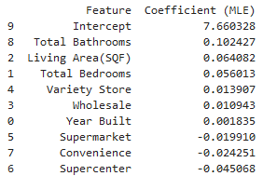
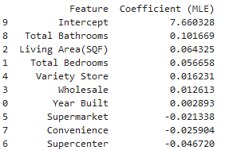
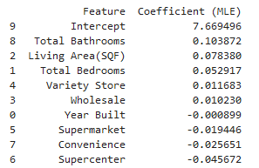
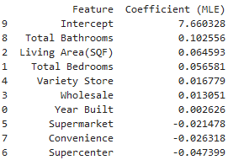
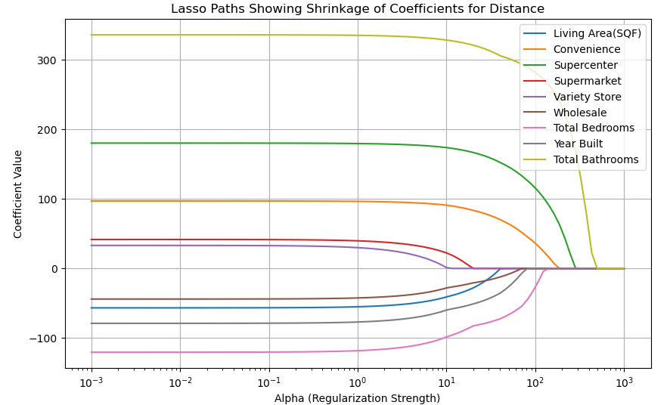
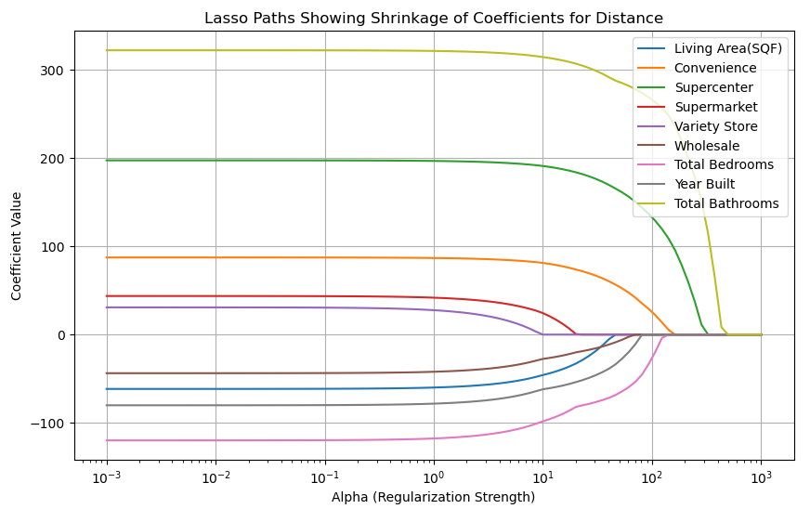
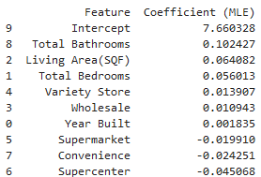
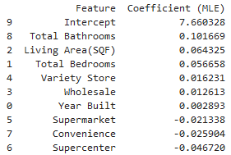
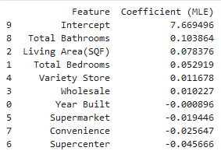
MLR: Distance
Lasso
MLR
Ridge
Notes:
Lasso regression applies a penalty on the absolute size of coefficients. As alpha increases:
Features with weaker or redundant relationships to the target variable are penalized more quickly, so their coefficients shrink to zero at lower alpha values.
Features with a stronger or more independent predictive relationship withstand the penalty longer, meaning their coefficients remain non-zero even at higher alpha values.
Therefore: If a feature’s coefficient doesn’t shrink to zero until a large alpha value, then the feature has a stronger influence.
The tables assume NO REGULARIZATION. The Lasso graph is more about model selection and interpretability in the context of regularized regression, while MLE coefficients are about unbiased estimation (under assumptions). Comparing the two highlights how regularization influences model parameters to prioritize sparsity and reduce overfitting.

Slide 20
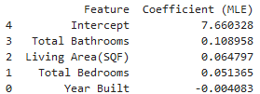
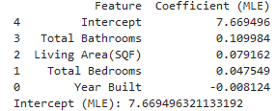
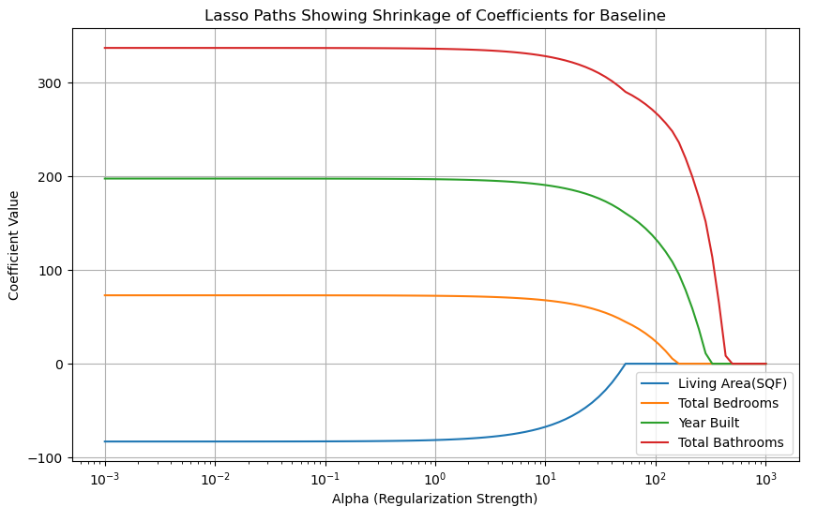

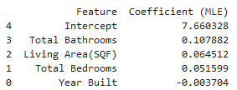
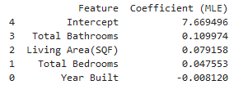
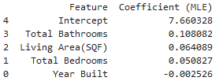
MLR: Baseline
MLR
Ridge
Lasso
Notes:
Bathrooms still has the strongest influence, as was the same when the independent variables were kept. Year built switches to a negative value instead of a positive one, although not by much. The regularization graph shows a heavier influence of year built, but that may just be because it’s one of the only features there.

Slide 21
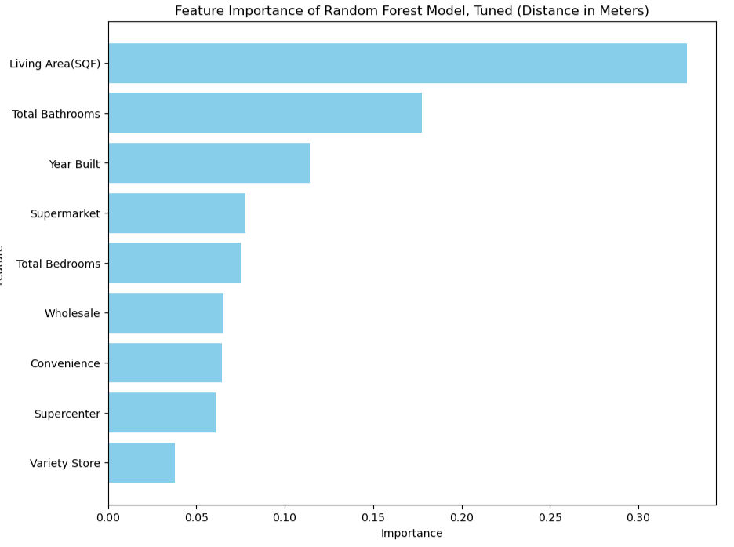
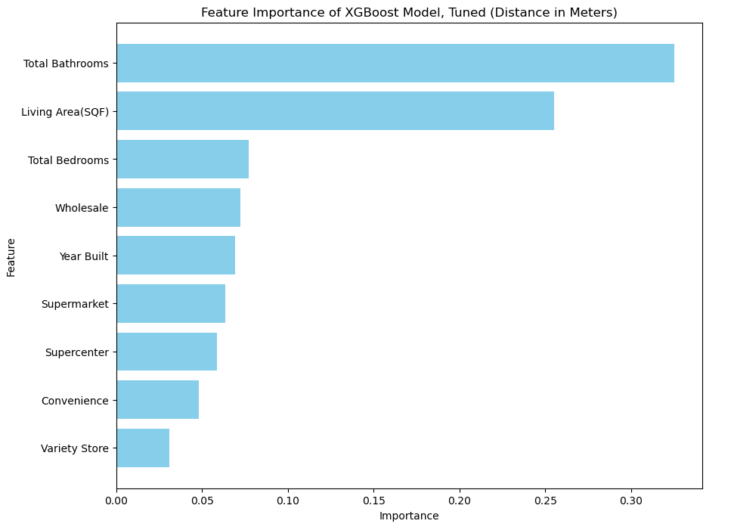
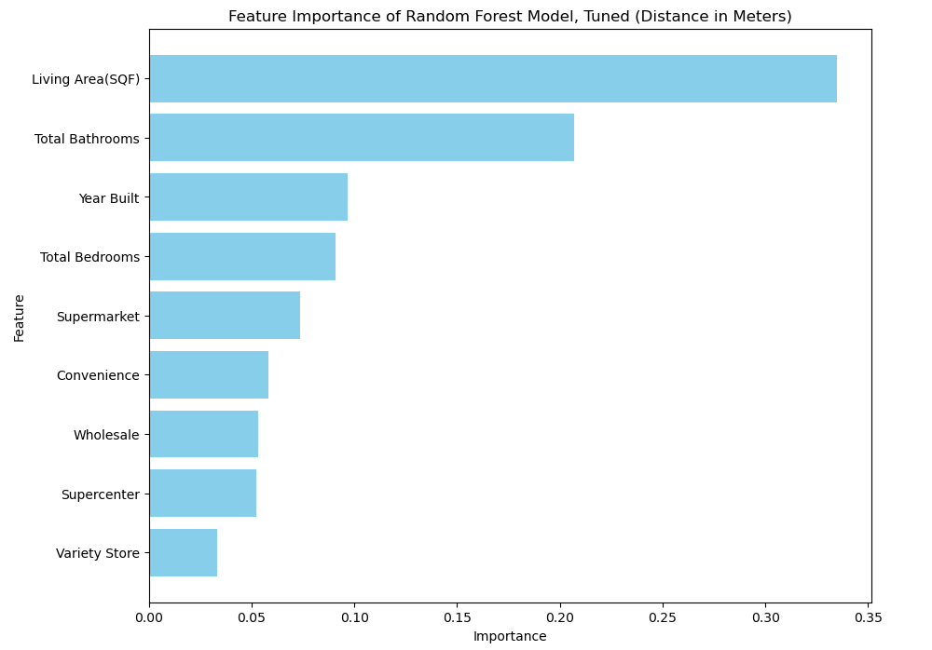
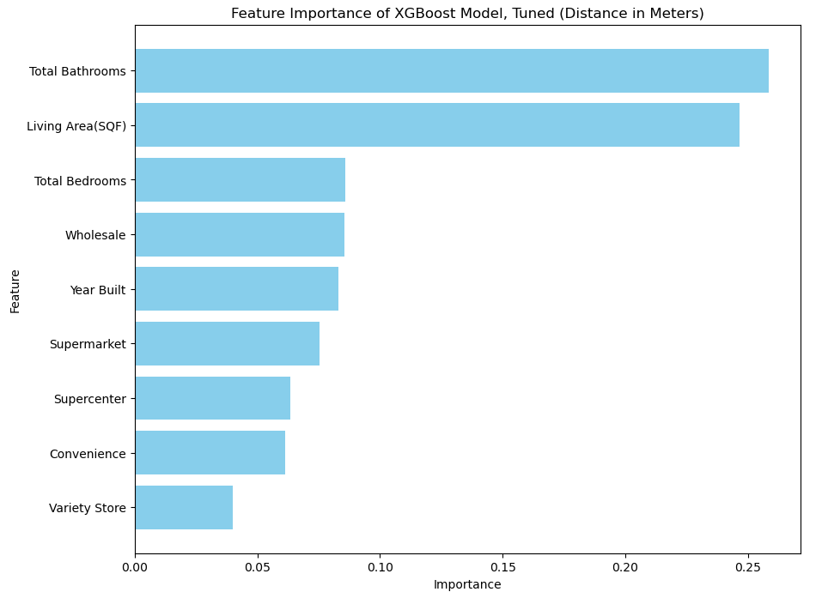
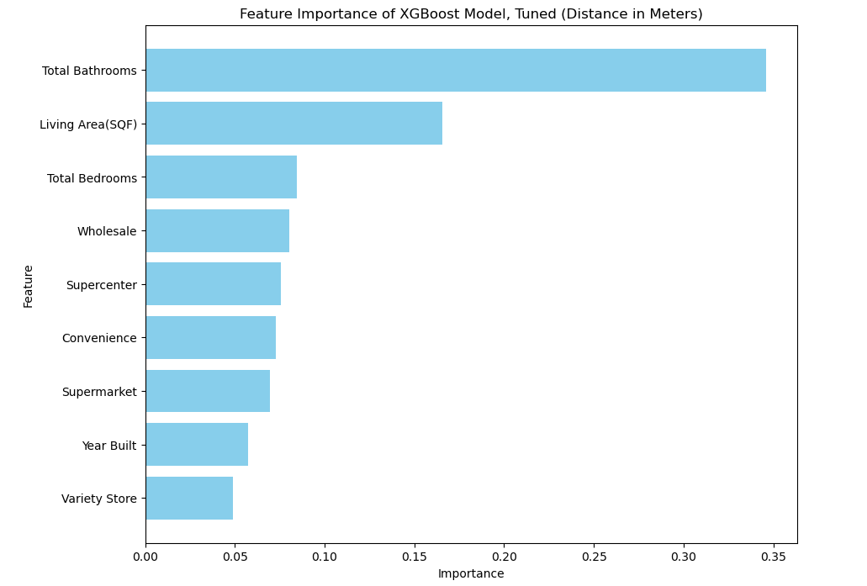
Random Forest: Distance
XGBoost: Distance
Notes:
Perhaps having the greatest disparity in results, the RF model says the greatest importances are Supermarket and Wholesale, while XGBoost says it’s Wholesale and Supermarket. This also goes against the Lasso regression, which claimed Supercenter should be the strongest influencer of the store features. Interestingly, total bathrooms is the most important for XGBoost, while living area is most important for random forest.

Slide 22
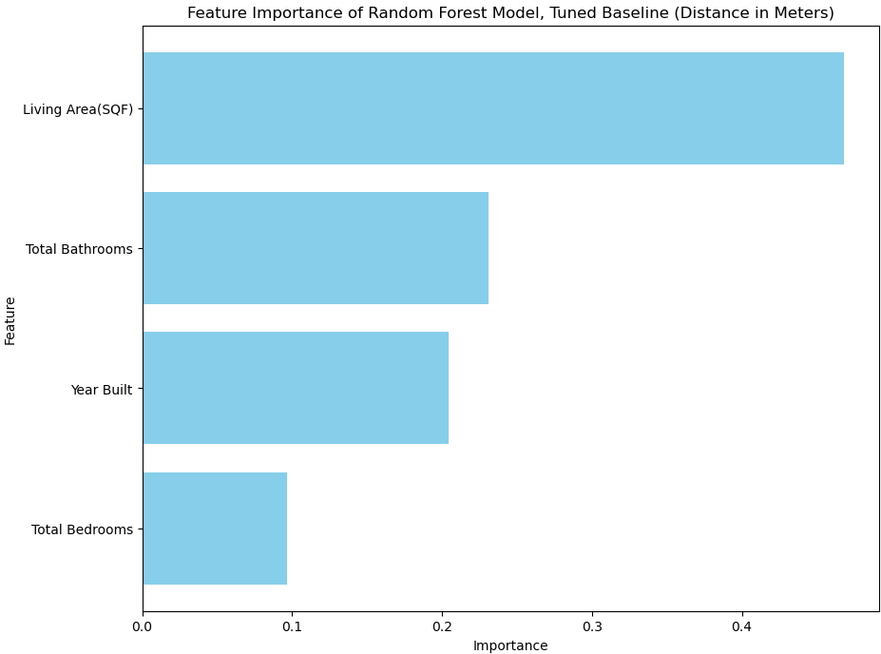
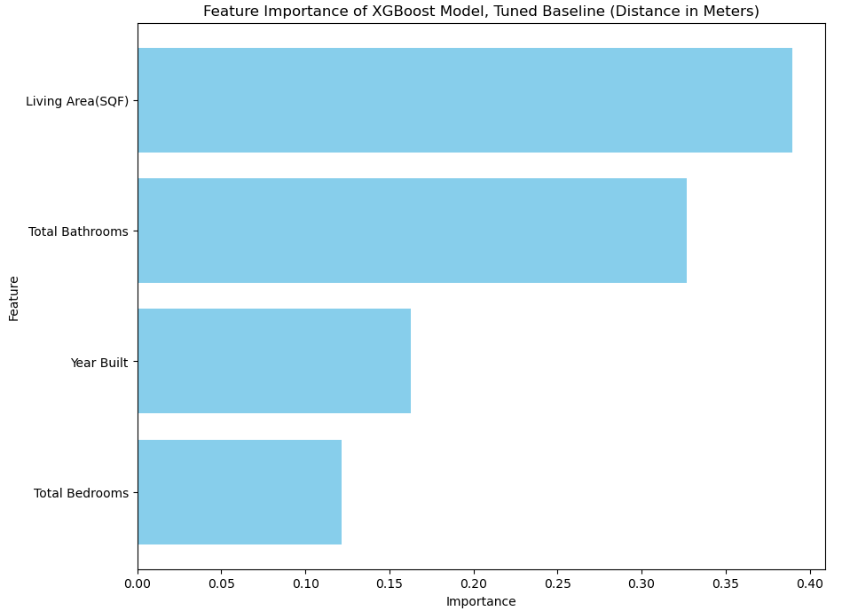
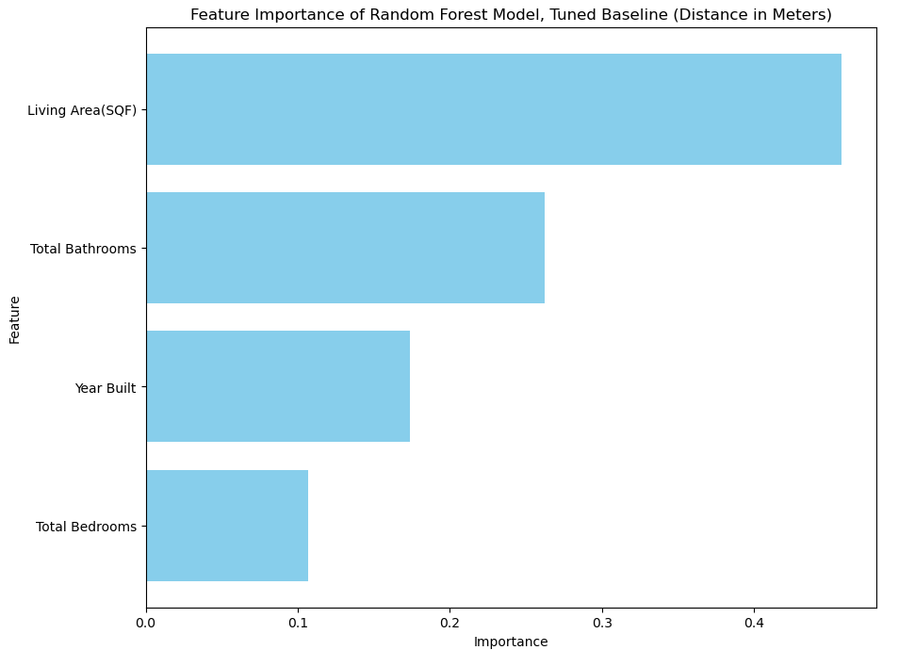
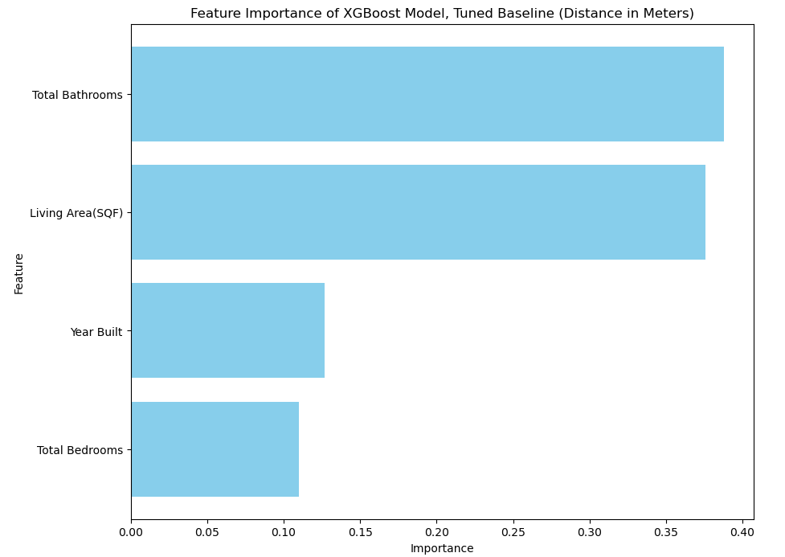
Random Forest: Distance
XGBoost: Distance
Notes:
Perhaps having the most bizarre difference, the XGBoost model does not inflate total bathrooms as much as it did when the IV’s were included. In addition, the importance is much, much higher compared to the other version. The Random forest model is more the same, though.

Slide 23
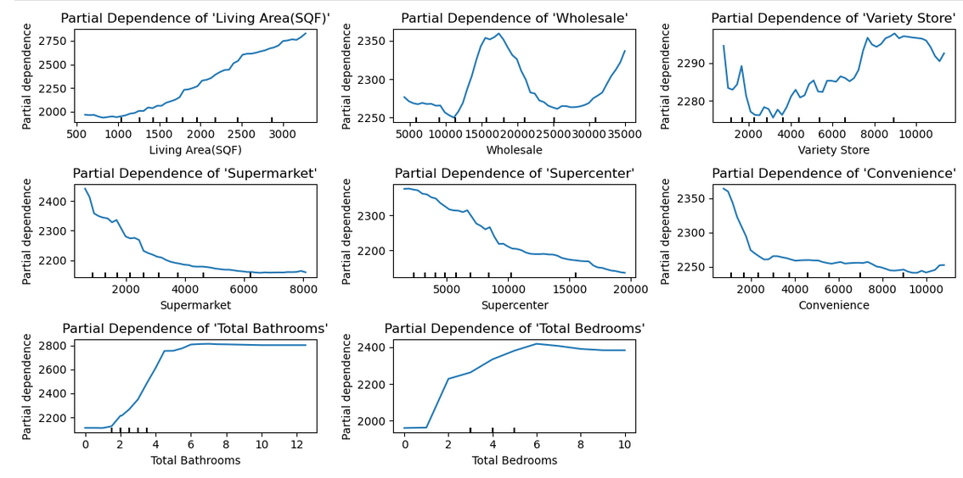
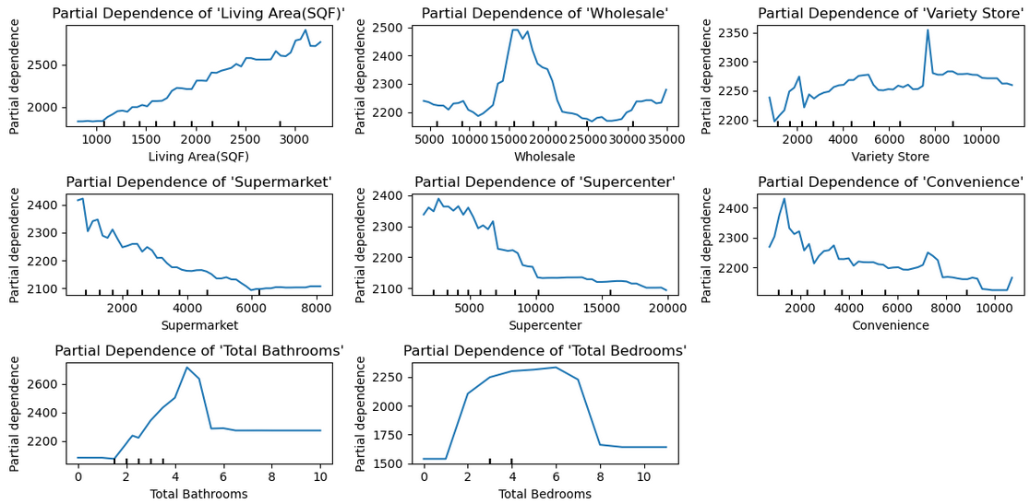
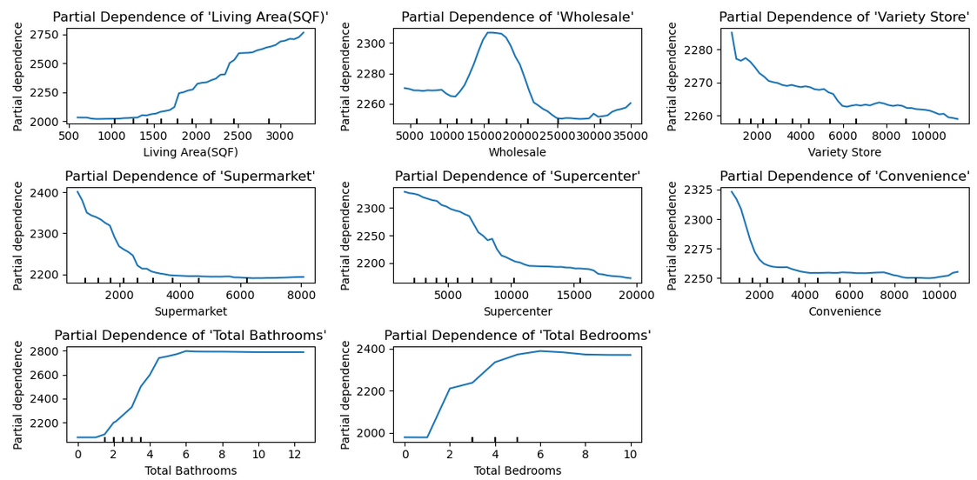
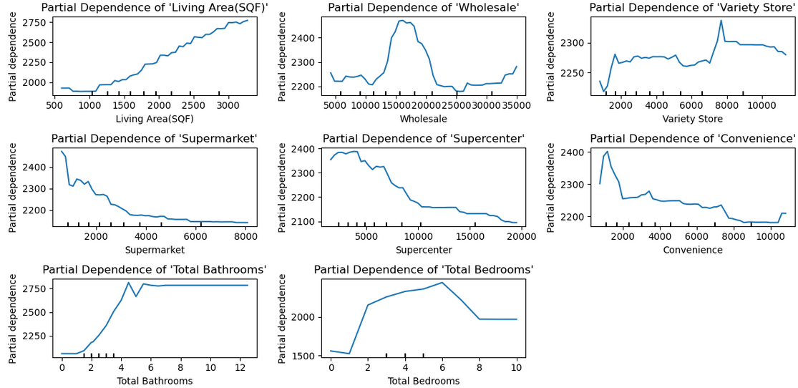
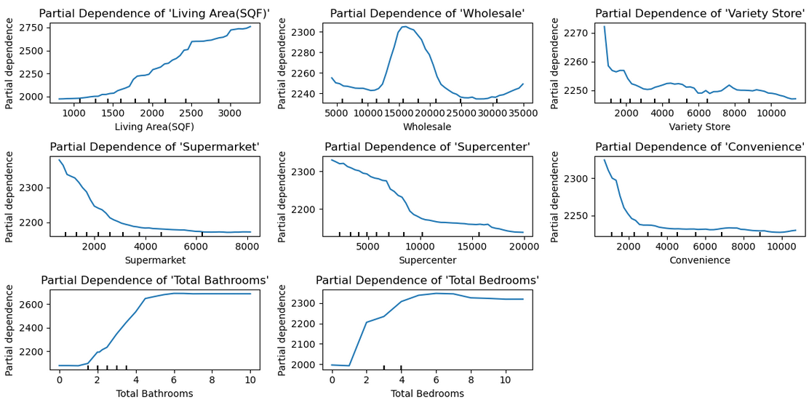
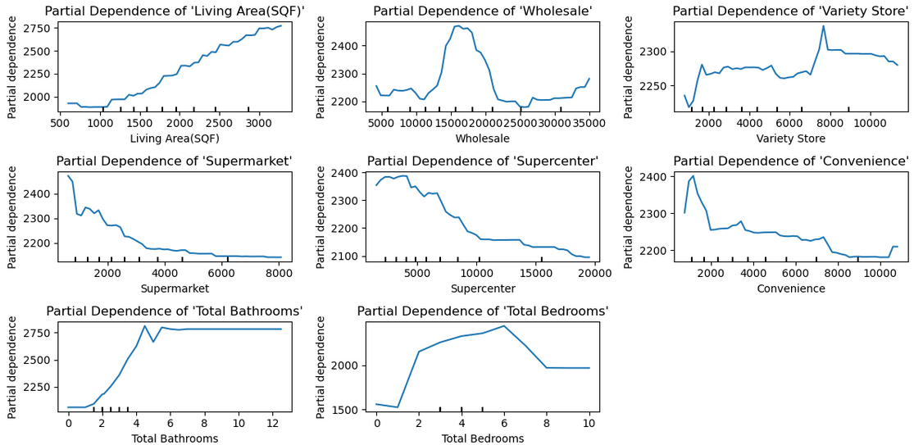
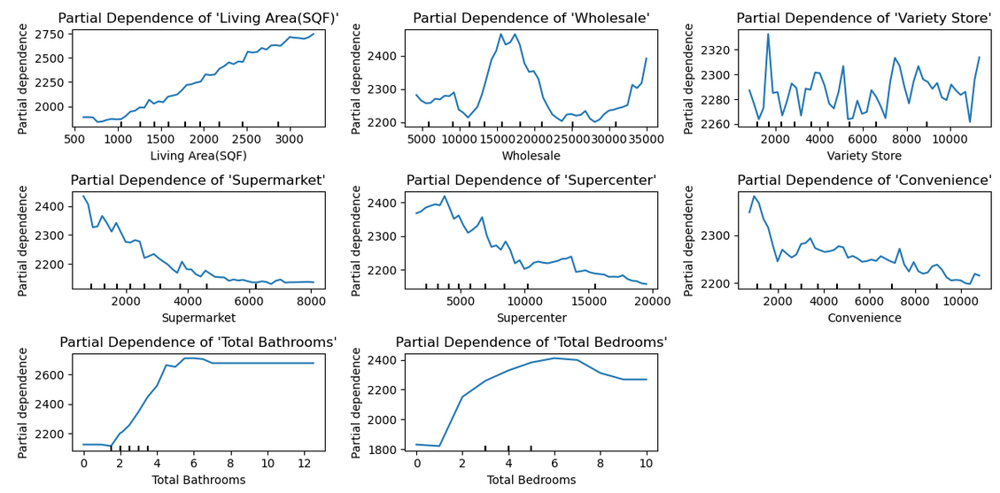
Random Forest: Distance, Partial Dependency Display
XGBoost: Distance, Partial Dependency Display
Notes:
Despite disagreeing on importance, the dependency is mostly the same except when it comes to variety store (which seems to be subject to noise). It would seem that, with the exception of wholesale, having the store closer is more critically important and then there is a sharp drop in dependency.

Slide 24
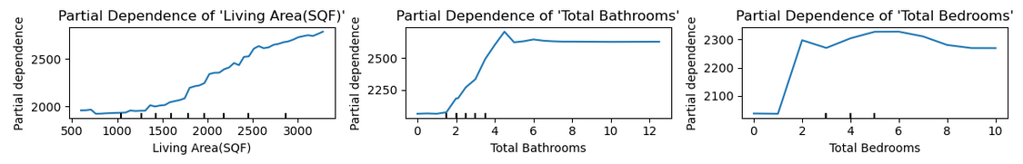
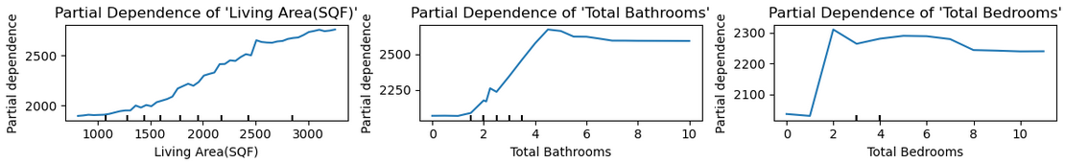
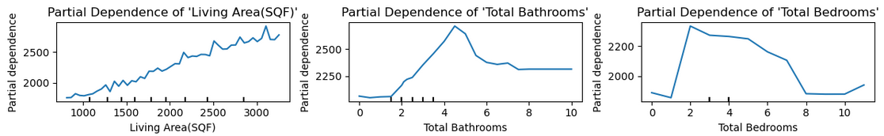
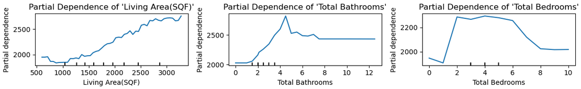
Random Forest: Baseline, Partial Dependency Display
XGBoost: Baseline, Partial Dependency Display
Notes:
Mostly tells the same as the previous graphs.

Slide 25
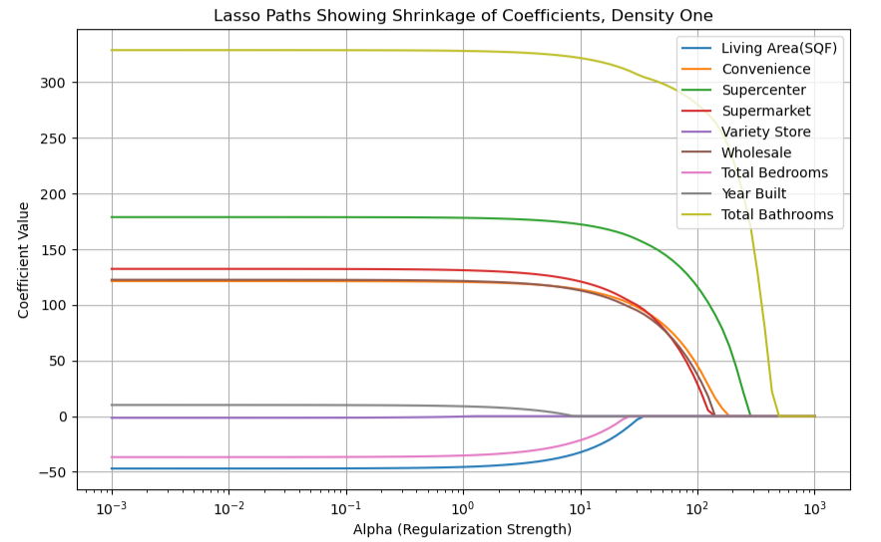
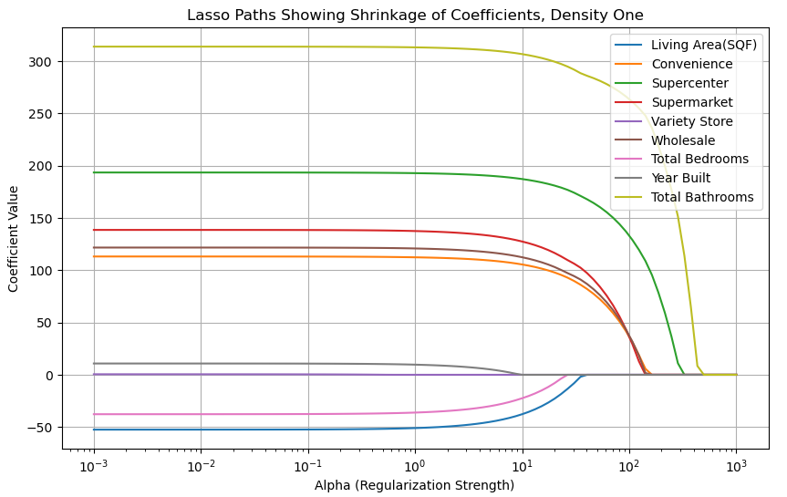
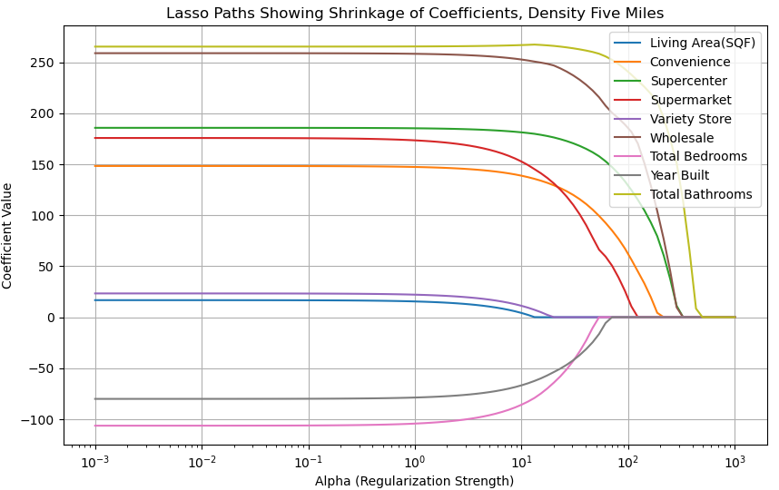
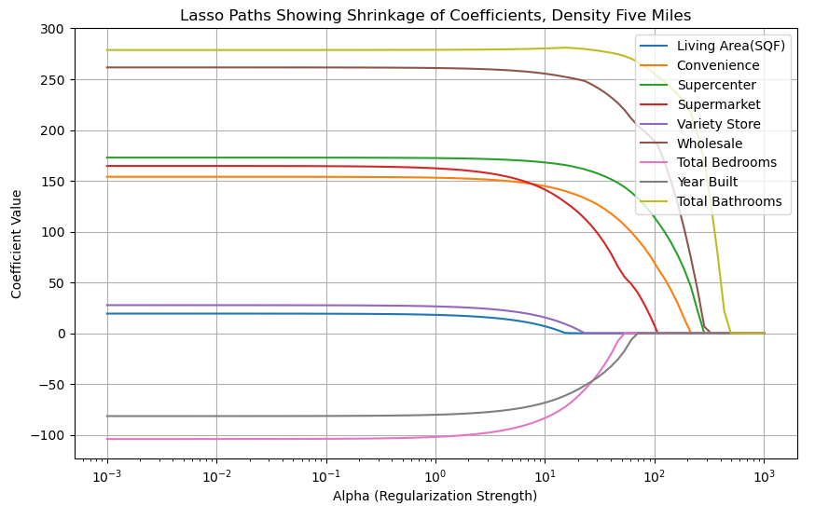
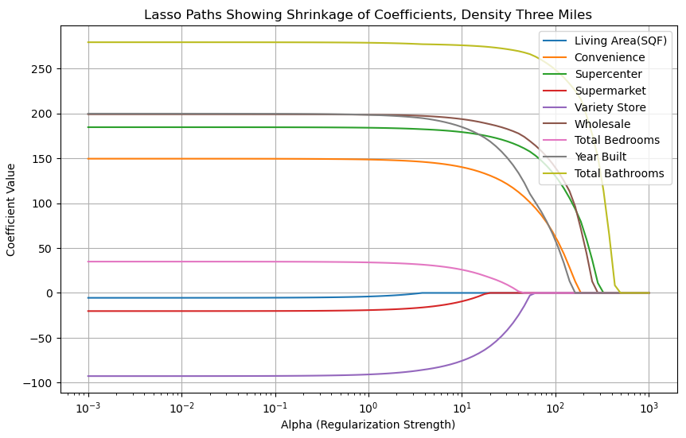
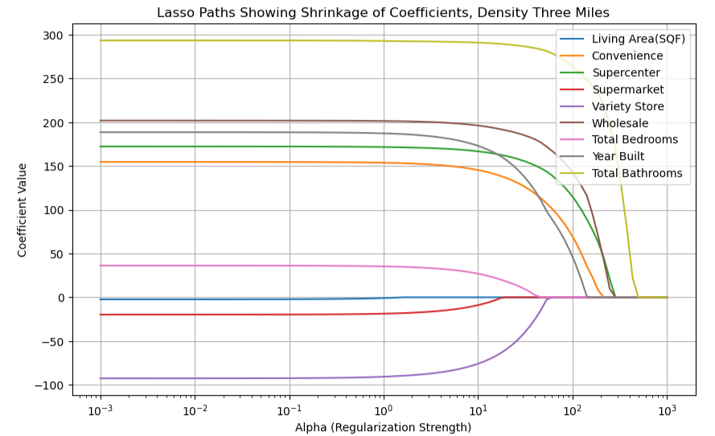
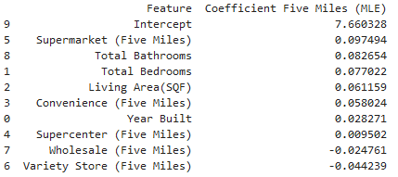
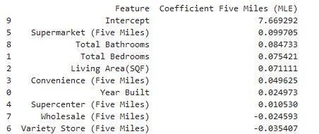
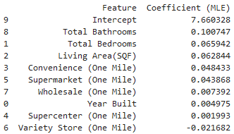
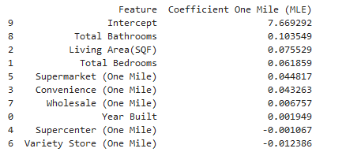
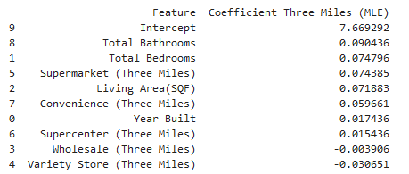
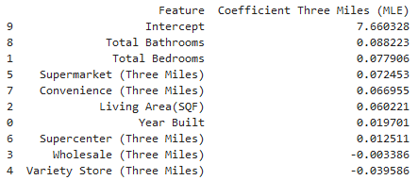
MLR: Density
Notes:
Wholesale and supercenters consistently show as withstanding the penalty longer, therefore having a stronger influence. Yet the coefficient argues that supermarkets are the strongest influencer, at one point even being THE strongest influencer when it comes to five miles.
At higher alpha, Lasso might assign a large coefficient to only Feature A (or Feature B), shrinking the other to zero to enforce sparsity. Some features might have larger coefficients at low alpha, but as alpha increases, those coefficients might shrink faster than others due to their weaker signal or correlation with other features.

Slide 26
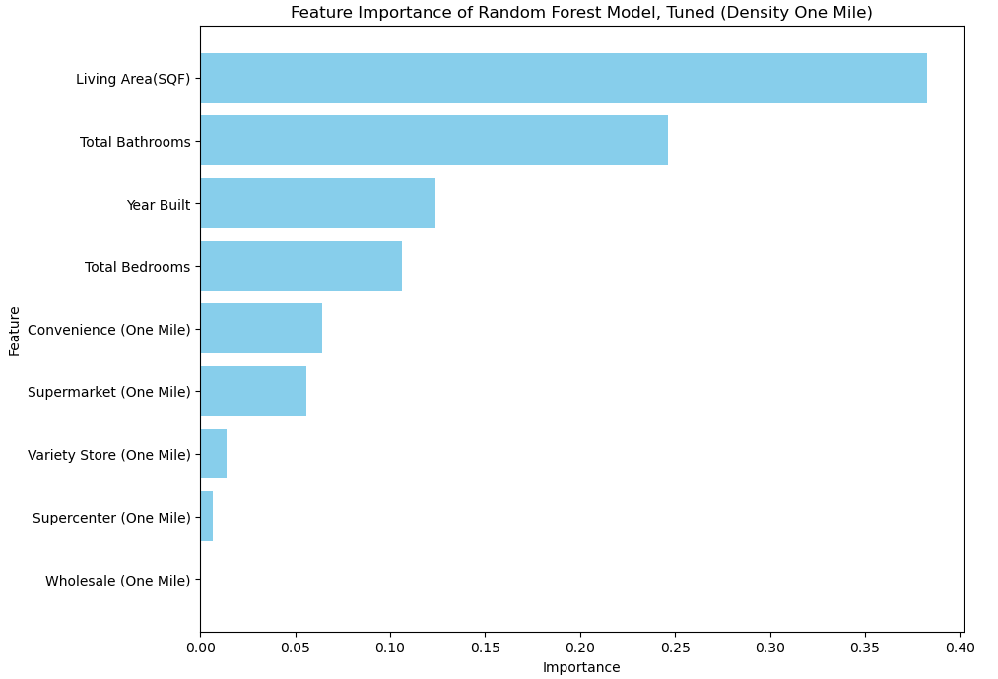
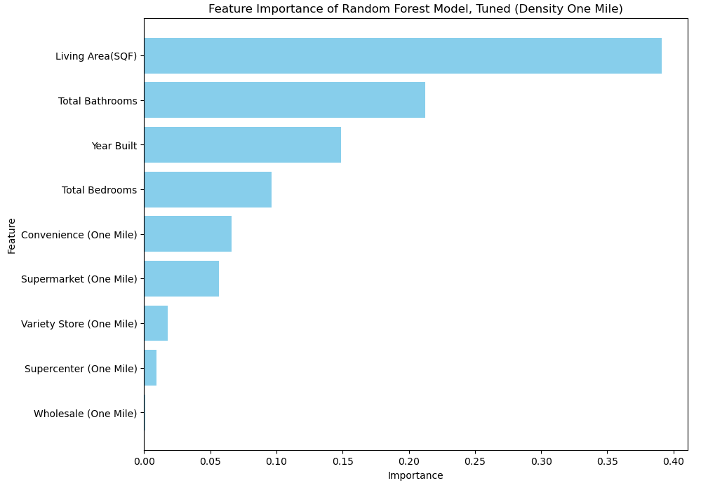
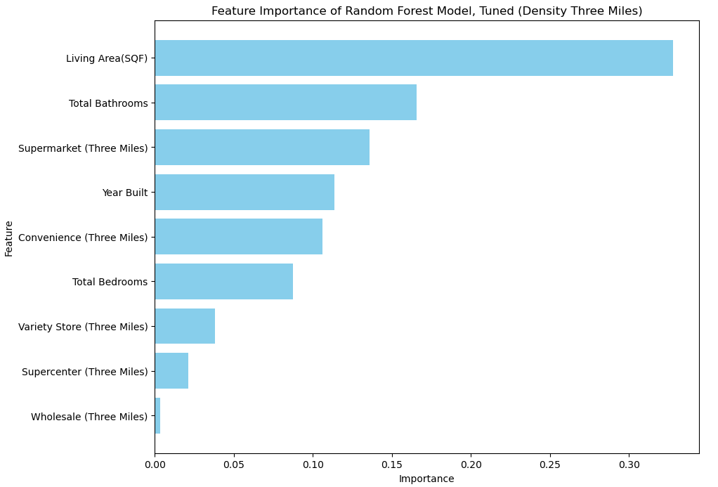






Random Forest: Density
Notes:
Supermarket and convenience stores vie for the top as the most influential factors. It seems as it approaches five, supermarkets will soon outpace even living area, as is consistent with the coefficients. Notably, Wholesale has almost no importance at one mile and then begins to gain some as the radius increases.

Slide 27









XGBoost: Density
Notes:
Unlike Random forest plot, the five miles implies a larger importance to wholesale, but overall a less max importance. Furthermore, Supermarket and Convenience are kept closer together in three miles.

Slide 28







Random Forest: Density, Partial Dependency Display (One Mile)
XGBoost: Density, Partial Dependency Display (One Mile)
Notes:
One mile seems to imply, for almost all features, that, as the amount increases, the dependency increases with the exception of variety store. However, we know variety store previously had noise attached to it.

Slide 29









Random Forest: Density, Partial Dependency Display (Three Miles)
XGBoost: Density, Partial Dependency Display (Three Miles)
Notes:
Perhaps adding more clarity, it would seem that, as more stores increase around the house, the dependency increases, EXCEPT for variety store and wholesale. In addition, bathrooms and bedrooms seem to flatline for random forest.

Slide 30







Random Forest: Density, Partial Dependency Display (Five Miles)
XGBoost: Density, Partial Dependency Display (Five Miles)
Notes:
Same applies here.

